Slide 1
UFCFB6-30-2 Object-oriented Software Development
Unit 6 Interaction modelling: Sequence Diagram
Benedict R. Gaster
2016-17

Slide 2
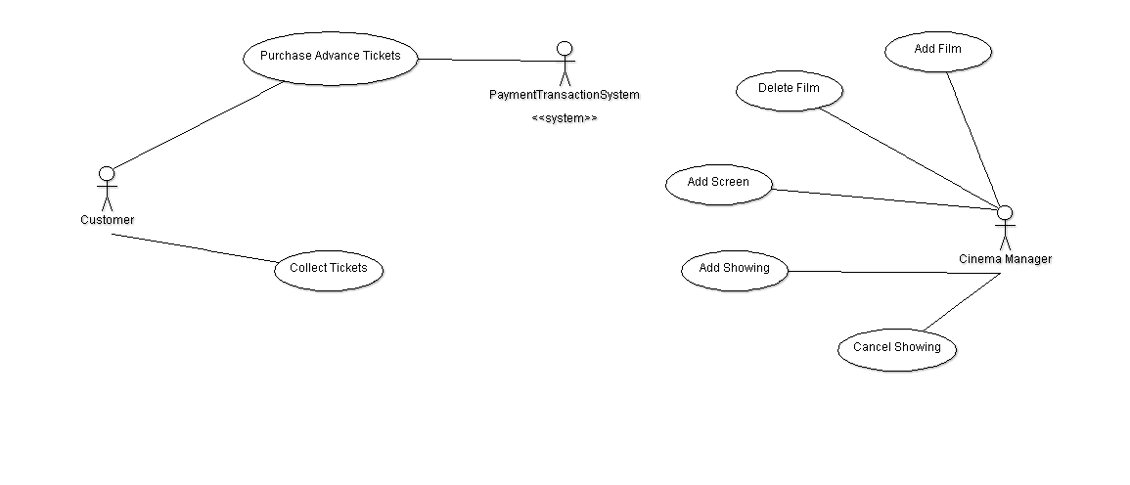
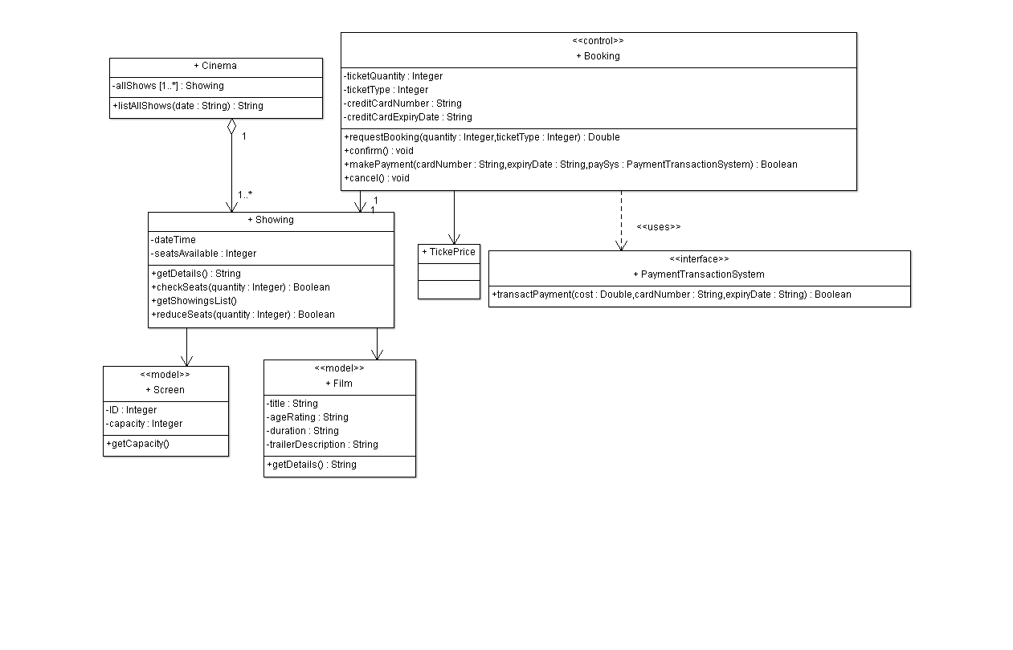
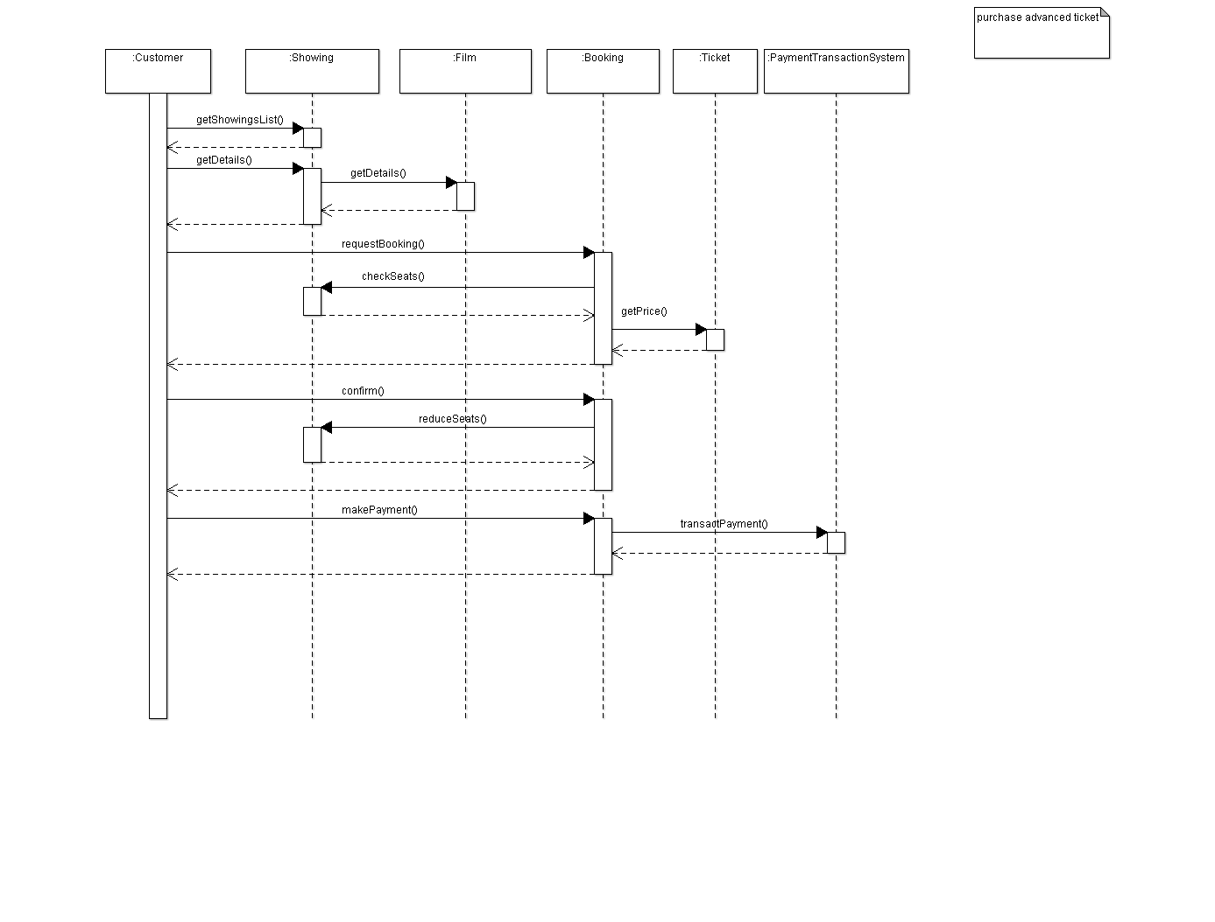

Slide 3
Outline
Interaction Modelling
Message passing
Notations in sequence diagram
From a Use Case to a Sequence Diagram
Iterative Design Process

Slide 4
Use cases, class diagrams and interaction modelling
Use cases model what your system must be able to do;
Classes model the different types of parts (building blocks) that make up your system’s structure.
They do not model how your system is actually going to do its job.
Interaction diagrams model important runtime interactions between the parts that make up your system and form part of the logical view of your model
Sequence diagram is one type of interaction diagrams.
Notes:
A use-case consists of related scenarios,
e.g. purchase product includes: if I pay by cash, I pay with a credit card and my card is declined.
The classes in the class diagram are the building blocks that are available to us to implement the functionality described in the use-case descriptions.
To model the dynamic runtime interactions we work through each use case and identify exactly what messages classes will need to send each other in order to implement the required behaviour.

Slide 5
Interaction Modelling
An interaction is a set of messages exchanged within a collaboration.
Message
Receiver
Sender
University
register ( Award )
Student
award
Register ( Award )
Selected Message
Parameter(s)

Slide 6
Message passing and Interaction modelling
The messaging between objects defines the interaction, the collaboration and control.
An object can only be accessed by sending a message to its public interface
These published services are performed by the receiving object, not the sending one.
The syntax of a message has a signature, being the required information to perform the service and the information delivered as a response.

Slide 7
Interaction Modelling in UML
We use interaction diagrams to capture the behaviour of objects at runtime.
UML interaction diagrams including sequence and communication diagrams.
Communication Diagrams emphasize the links between the various participants and represent the object interaction for chosen threads within the required system.
Sequence Diagrams emphasize the time ordering of messages and model the object interactions.

Slide 8
UML Interaction diagrams
Communication Diagrams
Sequence Diagrams
Communication Diagrams emphasize structural organization of objects
Sequence Diagrams emphasize time ordering of messages
Notes:
There are two interaction models within the current version of the Unified Modelling Language. These are collaboration models (originally used extensively by Grady Booch’s method) and Object Sequence Diagrams (used extensively by Ivar Jacobson in Objectory).
Due to their origins in two different methods their relationship to use cases is slightly different:
Collaboration Diagrams emphasize the structural organization of objects and represent the object interaction for chosen threads within the required system. This could, for example, be a single scenario (course) of a use case. Collaboration diagrams have no conditional construct and cannot therefore depict multiple scenarios;
Object Sequence Diagrams emphasize the time ordering of messages and model the object interactions for a single use case. Conditional constructs can be used to depict multiple scenarios (courses). Object Sequence Diagrams can also be used to model operations with significant interaction;
We will examine each of these diagram notations separately.

Slide 9
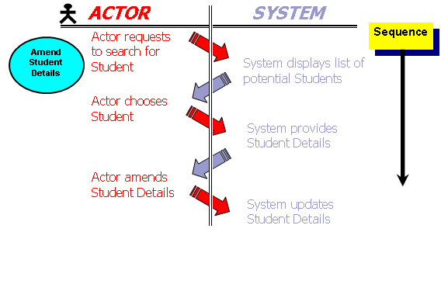
Example: Amend student record
Actor: requests to search for student
System: displays list of students
Actor: chooses student
System: provides student details
Actor: amend details
System: updates student details
Two possible classes:
Student class and StudentList class

Slide 10
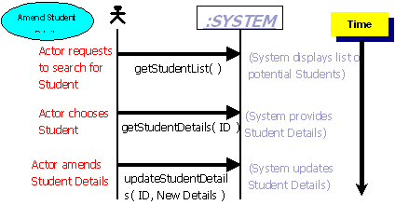
How actors send messages
Identified candidate messages between the actor and the system

Slide 11
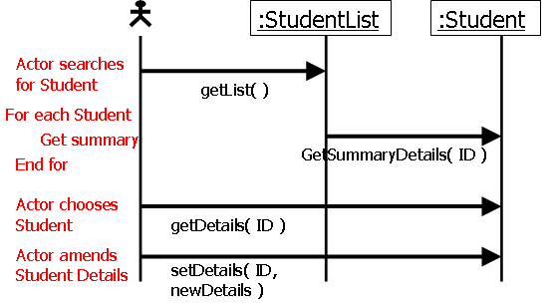
Assign messages to classes

Slide 12
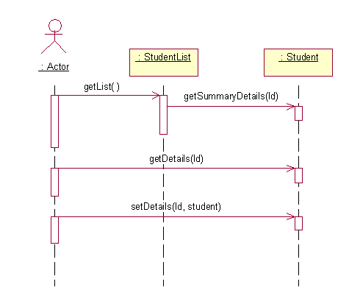
Amend student record sequence diagram

Slide 13
Notations in sequence diagram
Notes:
Each participant has a corresponding lifeline running down the page. A participant’s
lifeline simply states that the part exists at that point in the sequence and is
only really interesting when a part is created and/or deleted during a sequence (see
“Participant Creation and Destruction Messages” later in this chapter).

Slide 14
Amend student record sequence diagram

Slide 15
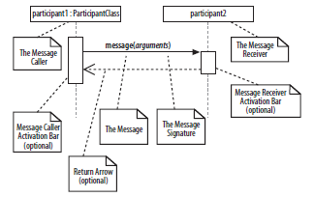
Notations in sequence diagram

Slide 16
Amend student record sequence diagram

Slide 17
Messages in sequence diagram
An interaction in a sequence diagram occurs when one participant decides to send a message to another participant,
Messages on a sequence diagram are specified using an arrow from the participant that wants to pass the message, the Message Caller, to the participant that is to receive the message, the Message Receiver.
Messages can flow in whatever direction makes sense for the required interaction—from left to right, right to left, or even back to the Message Caller itself.

Slide 18
Activation bar
When a message is passed to a participant it triggers, or invokes, the receiving participant into doing something; at this point, the receiving participant is said to be active.
To show that a participant is active, i.e., doing something, you can use an activation bar
An activation bar can be shown on the sending and receiving ends of a message. It indicates that the sending participant is busy while it sends the message and the receiving participant is busy after the message has been received

Slide 19
Nested Messages
When a message from one participant results in one or more messages being sent by the receiving participant, those resulting messages are said to be nested within the triggering message

Slide 20
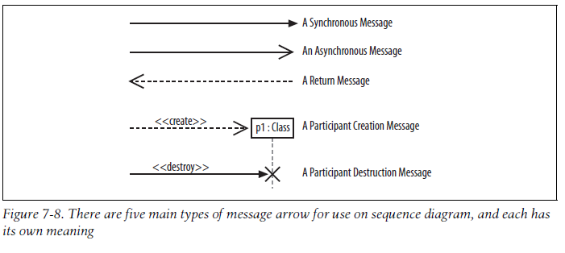
Message arrows

Slide 21
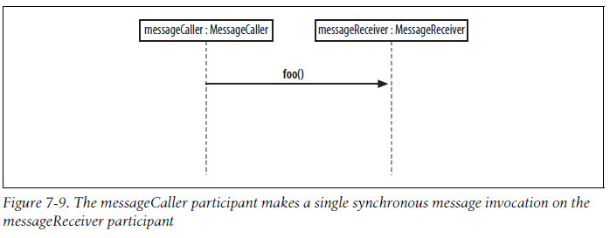
Synchronous messages
A synchronous message is invoked when the Message Caller waits for the Message Receiver to return from the message invocation

Slide 22
Synchronous message implementation
public class MessageReceiver {
public void foo() {
// Do something inside foo.
}
}
public class MessageCaller {
private MessageReceiver messageReceiver;
// Other Methods and Attributes of the class are
// declared here, including initialisation of messageReceiver
public doSomething(String[] args) {
// The MessageCaller invokes the foo() method
messageReceiver.foo();
// then waits for the method to return
// before carrying on here with the rest of its work
}
}

Slide 23
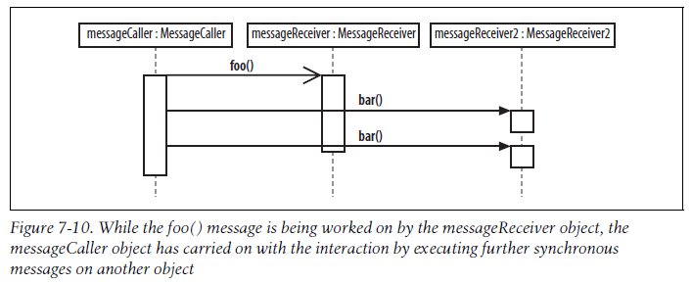
Asynchronous messages
A common way of implementing asynchronous messaging in Java is to use threads
Notes:
For example, say you are designing a piece of software with a user interface that supports
the editing and printing of a set of documents. Your application offers a button
for the user to print a document. Printing could take some time, so you want to
show that after the print button is pressed and the document is printing, the user can
go ahead and work with other things in the application. The regular synchronous
message arrow is not sufficient to show these types of interactions. You need a new
type of message arrow: the asynchronous message arrow.
An asynchronous message is invoked by a Message Caller on a Message Receiver, but
the Message Caller does not wait for the message invocation to return before carrying
on with the rest of the interaction’s steps. This means that the Message Caller
will invoke a message on the Message Receiver and the Message Caller will be busy
invoking further messages before the original message returns, as shown in
Asynchronous messages
With an asynchronous message, the sender does not wait for the receiver to finish processing the message, it continues immediately. Messages sent to a receiver in another process or calls that start a new thread are examples of asynchronous messages. An open arrowhead is used to indicate that a message is sent asynchrously.
Service starts Task and proceeds in parallel without waiting.
A message that does not require a response before the sender continues. An asynchronous message shows only a call from the sender. Use to represent communication between separate threads or the creation of a new thread.

Slide 24
Participant Creation and Destruction Messages
Either simply pass a create(..) message to the participant’s lifeline or use the dropped participant box notation where it is absolutely clear that the participant does not exist before the create call is invoked.

Slide 25
From a Use Case to a Sequence Diagram
Let’s look at a sequence diagram that is going to model the interactions that need to occur to make the Create a new Regular Blog Account use case happen.

Slide 26
The create a new Regular Blog Account use case diagram
Notes:
Specialized use cases can help you show different ways that your system can achieve the same goal.

Slide 27
Steps in Create a new Regular Blog Account use case
The Administrator asks the system to create a new blog account.
The Administrator selects the regular blog account type.
The Administrator enters the author’s details.
The author’s details are checked using the Author Credentials Database.
The new regular blog account is created.
A summary of the new blog account’s details are emailed to the author.

Slide 28
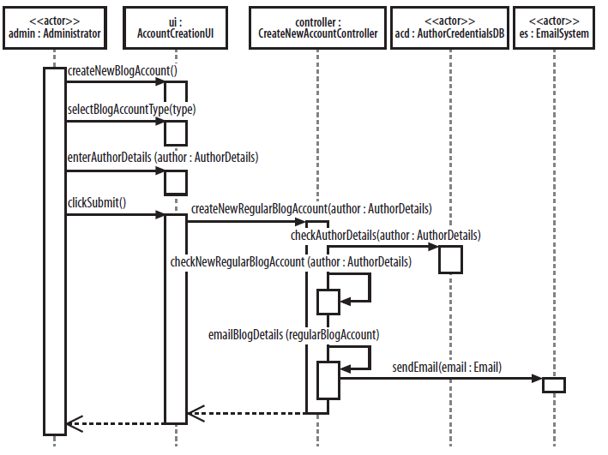
Sequence diagram for Create new Regular Blog Account

Slide 29
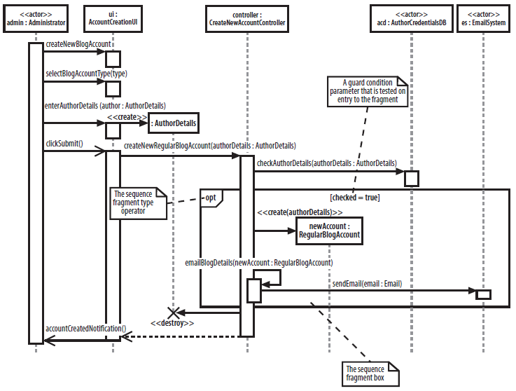
Complex interactions with sequence fragments
Notes:
the operator is opt, which means that this is an optional fragment. All
the interactions contained within the fragment box will be executed according to the
result of the fragments guard condition parameter.
Some fragment types do not need additional parameters as part of their specification,
such as the ref fragment type discussed in the next section, but the guard condition
parameter is needed by the opt fragment type to make a decision as to whether
it should execute its interactions or not. In the case of the opt fragment type, the
interactions that the fragment contains will be executed only if the associated guard
condition logic evaluates to true.

Slide 30
Iteration of dynamic & static views
Use Case
For each
use case
Class (static) view
Interaction (dynamic) view
Notes:
During interaction modelling, the use cases control the way in which the interactions between the objects are modelled. The process by which this information is modelled and consistency is enforced between the various views of the model is sometimes referred to as a micro-iteration. The process is repeated for each use case to be modelled.
The internal behavior of each use case is analyzed to help the understanding of the interactions between the classes. These new class responsibilities identified, along with any new classes that are discovered, represent additional information in the class diagram that must be reflected in the relevant class diagrams. Some of this happens automatically, but some additions must be made manually. The class diagrams must be further reviewed to identify any additional associations between classes which are implied by the interactions.
After a few iterations (typically 1, 2 or 3 depending on the complexity of the use case) the model settles down to a consistent state.
At this point, the next use case can be taken and modelled using the same micro-iterative process. Of course, changes to the underlying class diagram may cause us to review use cases that have already been modelled.

Slide 31
Iterative Design Process
New class responsibilities or new classes may be identified. The class diagrams must be further reviewed to identify any additional associations between classes which are implied by the interactions.
The process is repeated for each use case to be modelled.
Notes:
Use cases control the way in which the interactions between the objects are modelled.
The internal behavior of each use case is analyzed to help the understanding of the interactions between objects of different classes.

Slide 32
UWEFlix
Purchase Advance Tickets
The customer selects a date and is provided with a list of showings for that date, including the time of the showings. The customer selects a showing and is provided with details of the showing, including film title, age rating, duration, and a short trailer description. The customer then selects the quantity of tickets required, together with the ticket type. Ticket types may be one of student, child, or adult. The total cost of the booking is supplied to the customer. If the customer is happy, they then confirm their booking request.
If there are insufficient seats available at the showing, the booking request is cancelled and the customer is invited to make a further booking request. If there are sufficient seats, the customer confirms the booking and enters their payment card details, which include card number and expiry date. Payment cards may be one of two types – credit card or payment card. The payment is transacted.

Slide 33
Use case description – UWEFlix example (skip)
Advance Booking use case content:
Customer: selects a date
System: displays a list of showings.
Customer: selects a showing
System: displays details of showing
Customer: enters quantity of tickets required, together with the ticket type.
System: checks availability
Customer: confirms the booking
Customer: enters their payment card details, which include card number and expiry date.
The payment is transacted.
Advance Booking

Slide 34
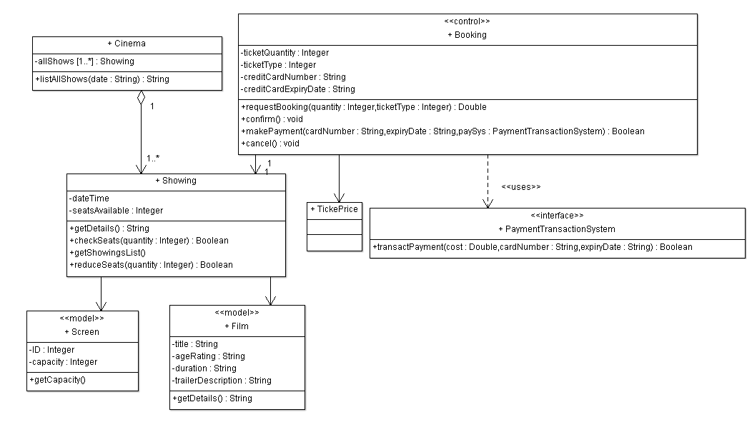
Partial class diagram for UWEFlix
Partial class diagram for UWEFlix

Slide 35
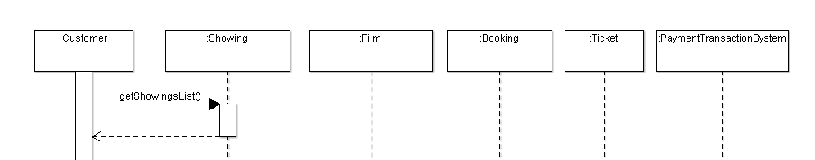
Partial sequence diagram for UweFlix AdvancedBooking

Slide 36
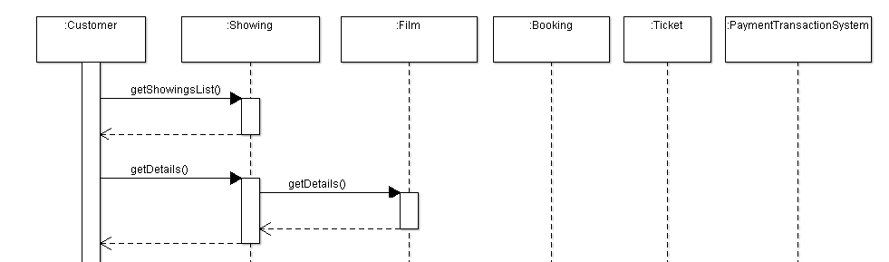
Partial sequence diagram for UweFlix AdvancedBooking

Slide 37
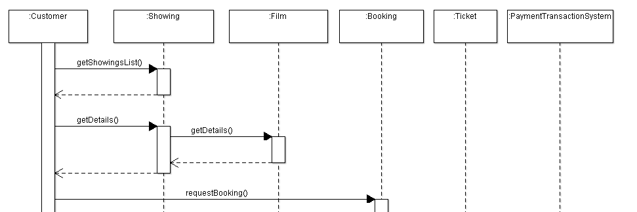
Partial sequence diagram for UweFlix AdvancedBooking

Slide 38
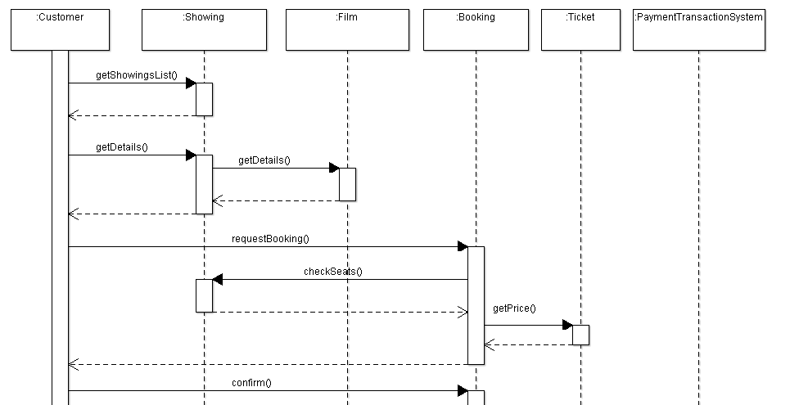
Partial sequence diagram for UweFlix AdvancedBooking

Slide 39
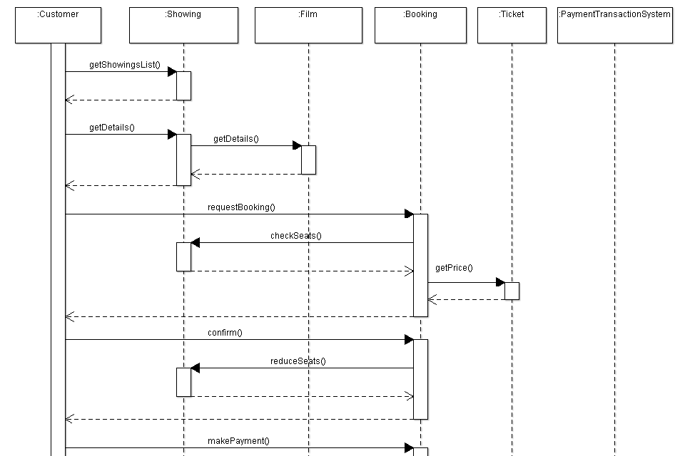
Partial sequence diagram for UweFlix AdvancedBooking

Slide 40
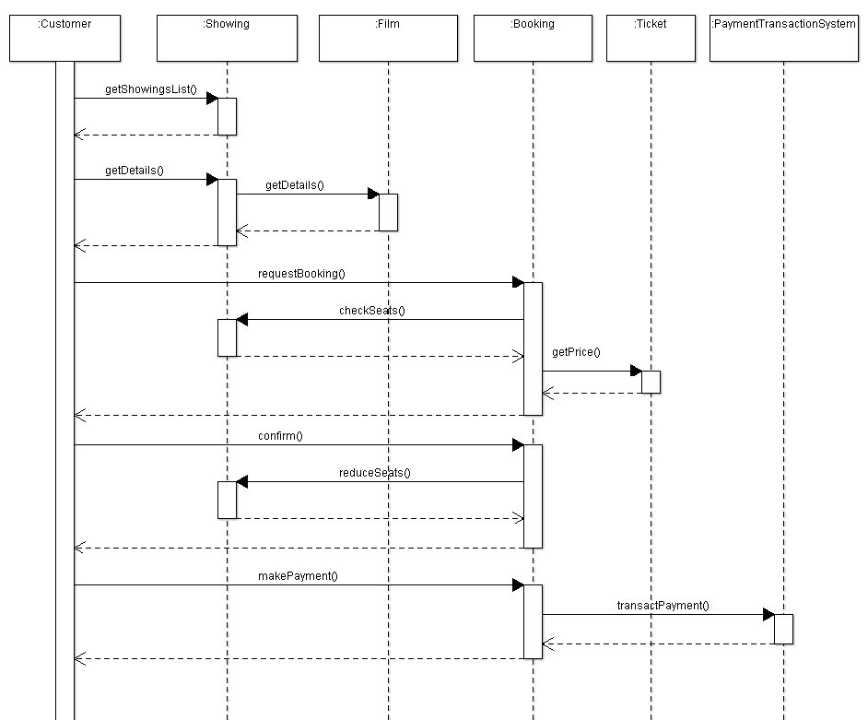
Partial sequence diagram for UweFlix AdvancedBooking

Slide 41
BookShop example
addBookTitle
purchaseBooks

